Slide 1

Biodiversity isn't just species
Biodiversity is the whole tree of life, not just the named species.
There are clades smaller and larger than the traditional species level.
Species are not comparable between lineages in any manner, just an arbitrary cut-off somewhere along a branch in the tree of life.
species

Slide 2
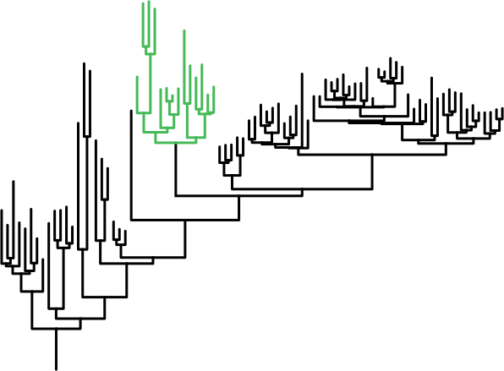
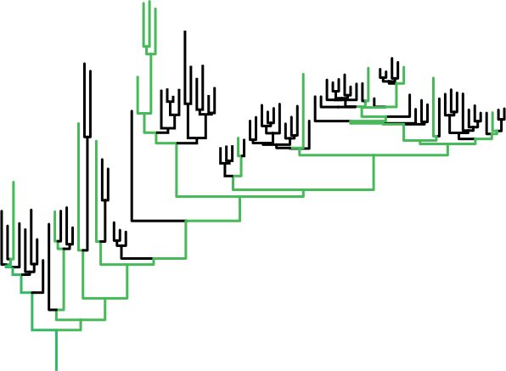
Measuring biodiversity
14 taxa
14 taxa
Taxonomic Richness
Phylogenetic diversity
Traditional metric: species richness
Alternative metric: phylogenetic diversity (PD)

Slide 3
Endemism isn't just species, either
Likewise, endemism is not just about species, even though virtually all studies on endemism to the present focus solely on species.
Clades at all levels can be endemic to a greater or lesser extent, and all levels are relevant to discovery and evaluation of centers of endemism.
Endemism, rather than being species-centric, should be more broadly defined to mean the geographic rarity of that portion of a phylogenetic tree found in a given area.
Thus for a full understanding of diversity and endemism, we need to look at the whole tree.

Slide 4
Methods for studying
phylogenetic diversity and endemism:
1. Two important measures to contrast with standard species diversity and endemism:
    PD = phylogenetic diversity, the portion of a phylogenetic tree present in a site.
    PE = phylogenetic endemism, PD weighted by how common those branches of the tree are elsewhere in the region.
2. Two derived measures that are proving to be powerful:
    RPD = relative phylogenetic diversity, the ratio of PD to a null hypothesis based on the numbers of terminals present.
    RPE = relative phylogenetic endemism, the ratio of PE to null hypothesis based on the endemism of terminals present.
  [significance of both is tested with a randomization approach]
Biodiverse software (http://code.google.com/p/biodiverse/ )

Slide 5
How is PD calculated?
Actual Tree, with random
selections of three terminals
0.15
0.05
0.20
0.10
0.05
0.10
0.25
0.10
0.15
0.05
PD = 0.90
0.20
0.10
0.25
0.05
0.10
PD = 0.55
0.10
0.15
0.05
0.20
PD ranges between
0.55 and 0.90; most
samples of three will
be around 0.70
0.10
0.05
0.10
0.25
PD = 0.70
0.10

Slide 6
4
How is PE calculated?
5
2
1
0.05
Actual Tree again, with unmodified branch lengths, showing the range size of terminal taxa in red
0.15
0.20
0.10
5
0.05
0.10
0.25
0.10
0.03
0.025
0.05
0.01
0.01
0.01
0.006
Actual Tree, but range-weighted, i.e., with each branch length divided by its range = PE
0.25
So PE is PD of a range-weighted tree!
Notes:
This is where the herbarium data come in!

Slide 7
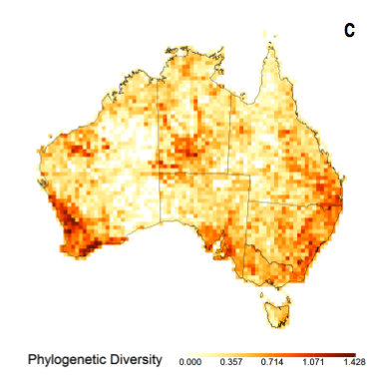
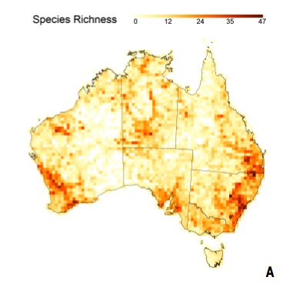
An example, Acacia in Australia
from: Mishler, B. D., N. Knerr, C. E. González-Orozco, A.H. Thornhill, S.W. Laffan, and J.T. Miller. (in press) Phylogenetic Approaches to Biodiversity, Endemism, and Conservation:
an Application to Australian Acacia, Nature Communications.
Need for hypothesis tests: raw values do not tell
us much, unless we understand how much to expect.

Slide 8
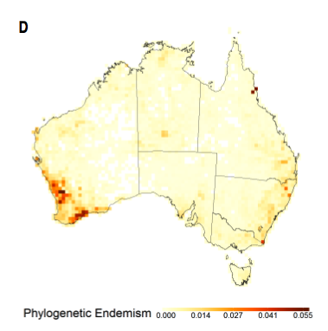
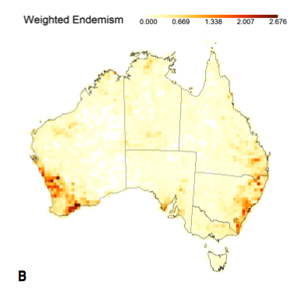
An example, Acacia in Australia:
Need for hypothesis tests: raw values do not tell
us much, unless we understand how much to expect.

Slide 9
No known null distribution for PD or PE → need to use a randomization test to generate a null expectation.
Our current randomization uses random reassignments of the same number of terminal taxa to a grid cell without replacement (thus keeping constant the total number of grid cells each species occurs in, and the richness of each grid cell), for 999 trials (there are other possible randomizations, of course).
An hypothesis test of PD or PE compares actual PD or PE to expected PD or PE -- but what tree(s) should we use to calculated the expected values?
One possibility is to use the actual tree: what do we expect if we randomly selected the same number of terminals from the exact same tree (branch lengths and all)?

Slide 10
That hypothesis test is highly dependent on the tree
topology, not very generalizable or comparable.
RPD and RPE were designed for more generalizable
hypothesis tests; both are ratios with PD and PE in the
numerator, respectively.
In the denominator is a null tree representing what you expect
with a given number of terminals, given different, more general
null hypotheses, more comparable across analyses.
We have explored different null trees, suitable for
testing slightly different hypotheses. I will show one here that we think is the most general-purpose.

Slide 11
Actual Tree again, with random selections of three terminals
0.15
0.05
0.20
0.10
0.05
0.10
0.25
0.10
0.15
0.05
PD = 0.90
0.20
0.10
0.25
0.05
0.10
PD = 0.55
0.10
0.15
0.05
0.20
PD ranges between
0.55 and 0.90; most
samples of three will
be around 0.70
0.10
0.05
0.10
0.25
PD = 0.70
0.10

Slide 12
Null tree
this retains the branching
topology of the actual tree
but make all branches
equal length →
"all branches are equal"
0.125
0.125
0.125
0.125
0.125
0.125
0.125
0.125
0.125
0.125
0.125
0.125
0.125
0.125
PD = 0.625
PD = 0.75
0.125
0.125
(PD ranges between 0.625 and 0.75)

Slide 13
calculation of RPD
0.15
0.05
0.20
0.10
0.05
0.125
0.10
PD = 0.70
0.125
0.25
0.125
0.10
0.125
Actual tree
0.125
0.125
0.125
PD = 0.625
0.125
RPD = 0.70/0.625 = 1.12
(probably not significant)
Null tree

Slide 14
calculation of RPD
0.15
0.05
0.20
0.10
0.125
0.125
0.05
PD = 0.90
0.125
0.10
0.25
0.125
0.10
0.125
0.125
Actual tree
0.125
PD = 0.75
0.125
Null tree
RPD = 0.90/0.75 = 1.2
(probably significantly high)

Slide 15
calculation of RPD
0.15
0.05
0.20
0.10
0.125
0.125
0.25
0.05
0.10
0.125
PD = 0.55
0.125
0.10
0.125
Actual tree
0.125
0.125
PD = 0.75
0.125
RPD = 0.55/0.75 = 0.73
(probably significantly low)
Null tree

Slide 16
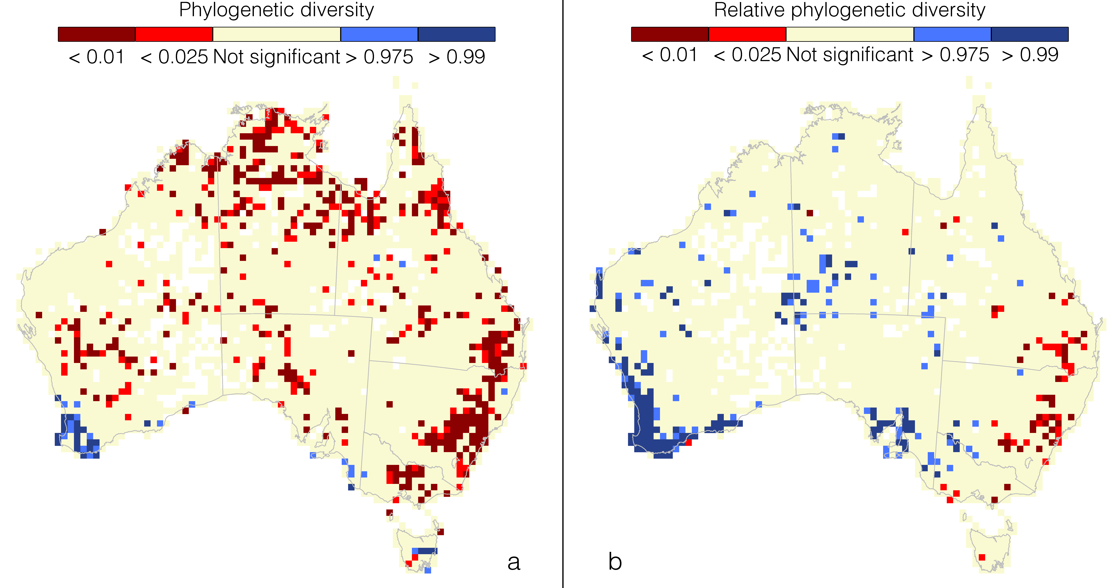


Slide 17
Relative Phylogenetic Diversity
Significantly high RPD indicates an area where there is an over-representation of long branches, in other words a high amount of feature diversity.
This could have alternative explanations. One possibility is that the area is a refugial one containing relicts from past climate change, or as the result of competition that prohibits close relatives from co-occurring in the same communities (i.e., phylogenetic overdispersion, Webb et al. 2002)

Slide 18
Relative Phylogenetic Diversity
Significantly low RPD indicates an area where there is an over-representation of short branches. This pattern also could have alternative explanations, including that the area is a place of recent divergence of lineages, or as the result of habitat filtering based on phylogenetically conserved traits that results in close relatives co-occurring in the same communities (i.e., phylogenetic clustering, Webb et al. 2002).

Slide 19
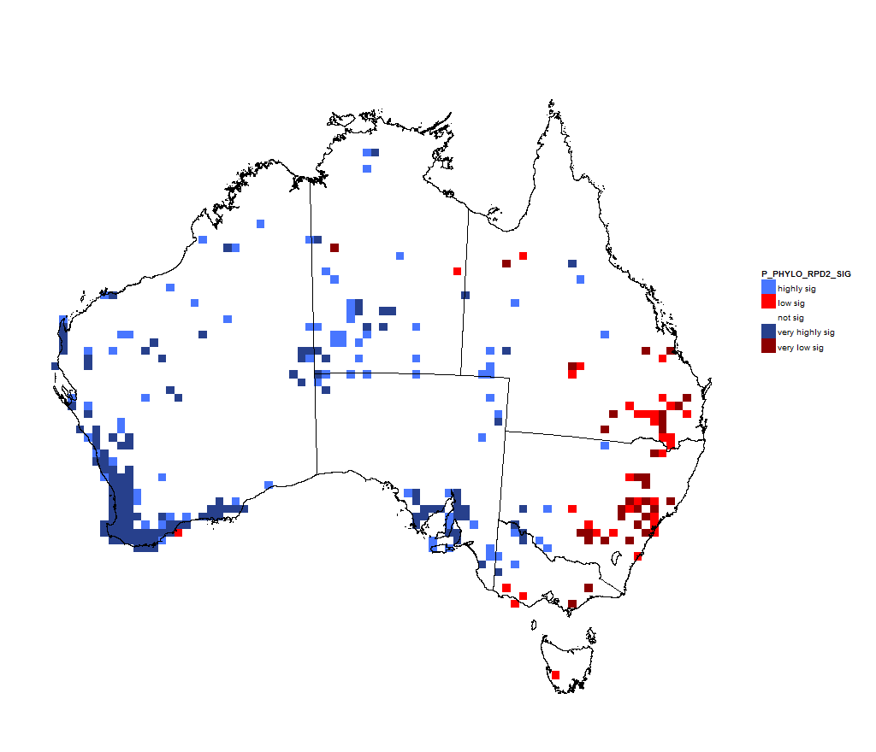
An example, Acacia in Australia:
real tree shape
RPD = ratio of PD of actual tree to PD of null tree. Blue = over-representation of long branches; red = over-representation of short branches.
null tree shape

Slide 20
Neo-endemism vs. Paleo-endemism
RPE can be used to separate areas dominated by neoendemism from areas dominated by paleoendemism, and can give insights into evolutionary and ecological processes that may be responsible for such patterns.
Significantly high RPE could indicate an area where there is an over-representation of long branches that are rare on the landscape (i.e, paleoendemics).
Significantly low RPE could indicate an area where there is an over-representation of short branches that are rare on the landscape (i.e., neoendemics).

Slide 21
CANAPE: Categorical Analysis of
Neo- And Paleo-Endemism
Using RPE to find and classify centers of endemism.
Remember, RPE is ratio of PE on the actual tree to PE on the null tree.
There is a two-step process:
First, to determine if a place is a center of significantly high endemism, a grid cell needs to be significantly high (one-tailed test) in either the numerator, the denominator, or both.

Slide 22
CANAPE: Categorical Analysis of
Neo-and Paleo-Endemism
Second, if (and only if) a grid cell passes one of those tests, then we divide the centers of endemism into three meaningful, non-overlapping categories:
if a point is significantly high or low in RPE (two-tailed test), then it is a center of paleo-endemism or neo-endemism respectively.
if it is significantly high in both the numerator and the denominator (taken alone), but not significant for RPE, then it is a center of super-endemism.

Slide 23
Reminder of how PE is calculated:
Actual tree:
5
4
2
1
0.15
0.05
0.20
0.10
5
0.05
0.10
0.25
Actual tree, range weighted:
0.10
0.03
0.025
0.05
0.01
0.01
0.01
0.006
0.25
Notes:
This is where the herbarium data come in!

Slide 24
Actual tree:
calculation of RPE
a rare short branch
5
4
2
1
0.15
0.05
0.20
0.10
5
Actual tree, range weighted:
0.05
0.10
0.25
a rare long branch
0.03
0.10
0.025
0.05
0.01
0.25
0.01
0.01
0.017
0.025
0.062
0.006
0.125
0.031
0.0125
0.025
0.008
Null tree, range weighted
The rare long branch is longer in the RW actual tree than expected under the null.
The rare short branch is shorter in the RW actual tree than expected under the null.
Notes:
This is where the herbarium data come in!

Slide 25
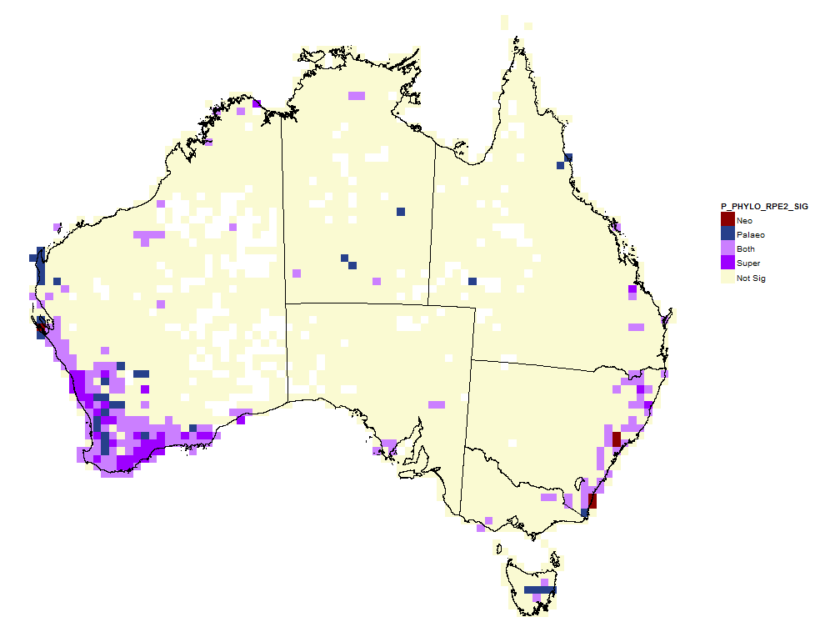
An example in Acacia:
RPE -- ratio of PE of actual tree to PE of null tree.
blue interpreted as center dominated by paleoendemism; red = same for neoendemism. Purple is interpreted as a center high in both.

Slide 26
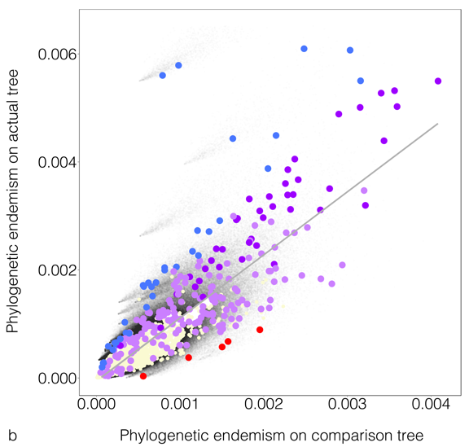
Result of CANAPE analysis:
Significant grid cells only
Blue dots are centers of paleoendemism
Dark purple dots are
centers of superendemism
Red dots are centers of neoendemism

Slide 27
An example, Acacia in Australia:
Paleo-
Paleo-
Super-
Neo-
Super-
Neo-
Need for hypothesis tests: raw values of PD or PE do not tell
us much, unless we understand how much to expect.

